Slide 1
Unit 4 Clustering
References
https://www.datavedas.com/hierarchical-clustering/
https://researchhubs.com/post/ai/fundamentals/agglomerative-hiera rchical-clustering-algorithm-numerical-example.html
IITKharagpur CS40003: Data Analytics

Slide 2
Unit – 4 Syllabus
Clustering: Introduction
Hierarchical Clustering:
Agglomerative Clustering Algorithm
The single Linkage Algorithm
The Complete Linkage Algorithm
The Average – Linkage Algorithm
Partitional Clustering:
Forgy’s Algorithm
The K-Means Algorithm

Slide 3
Cluster: A collection of data objects
Similar (or related) to one another within the same group Dissimilar (or unrelated) to the objects in other groups
The objective of cluster analysis is to assign observations to groups (clusters) so that observations within each group are similar to one another
with respect to variables or attributes of interest, and the groups themselves stand apart from one another.
In other words, the objective is to divide the observations into homogeneous and distinct groups

Slide 4
The goal of clustering is to
group data points that are close (or similar) to each other
identify such groupings (or clusters) in an unsupervised manner
Unsupervised: no information is provided to the algorithm on which data points belong to which clusters
Example
What should the clusters be for these data points?
x
x
x
x
x _{x}
x
x
x

Slide 5
Cluster analysis (or clustering, data segmentation, …)
Finding similarities between data according to the characteristics found in the data and grouping similar data objects into clusters
Unsupervised learning: no predefined classes (i.e., learning by observations)
Typical applications
As a stand-alone tool to get insight into data distribution As a preprocessing step for other algorithms
Some Applications of Clustering
Pattern Recognition
Image Processing : cluster images based on their visual content Bio-informatics
WWW and IR : Document classification
cluster Weblog data to discover groups of similar access patterns

Slide 6
Example 1: Groups people of similar race and built,
Clothes of similar sizes together to make “small”, “medium” and “large” category.
Example 2: In marketing, segment customers according to their similarities To do targeted marketing.
Example 3: Given a collection of text documents, we want to organize them according to their content similarities : To produce a topic hierarchy

Slide 7
Clustering: Task of grouping a set of data points such that data points in the same group are more similar to each other than data points in another group (group is known as cluster)
It groups data instances that are similar to (near) each other in one cluster and
data instances that are very different (far away) from each other into different clusters.
Types of clustering:
Hierarchical Clustering: Agglomerative clustering, divisive clustering
Partitional Clustering
Forgy’s Algorithm
Exclusive Clustering: K-means
Isodata (Combination of Forgy’s and k Means)
Probabilistic Clustering: Mixture of Gaussian models

Slide 8
What Is Good Clustering?
A good clustering method will produce high quality clusters with
high intra-class similarity
low inter-class similarity
The quality of a clustering result depends on both the similarity measure used by the method and its implementation.
The quality of a clustering method is also measured by its ability to discover some or all of the hidden patterns.

Slide 9
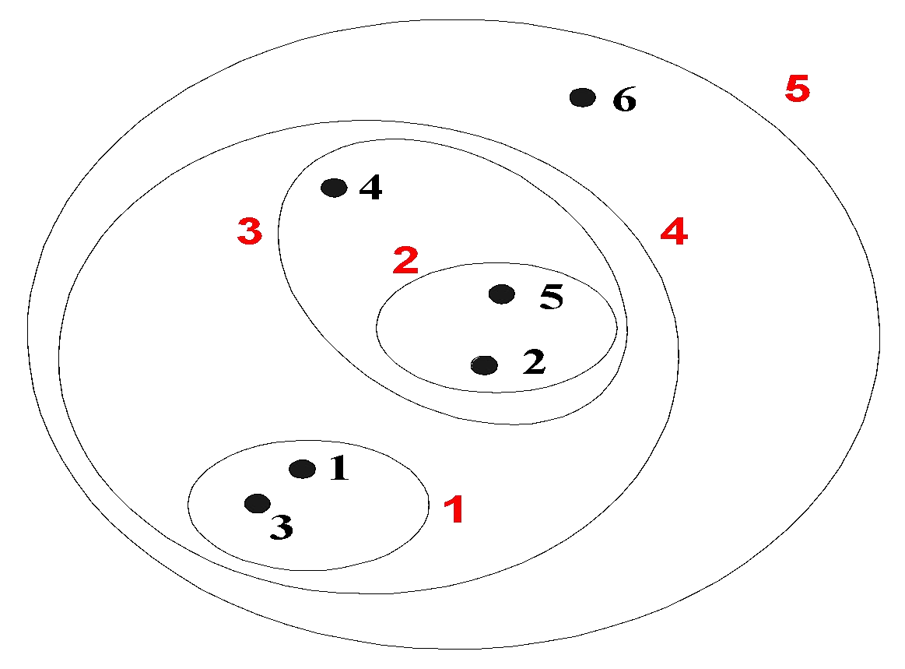
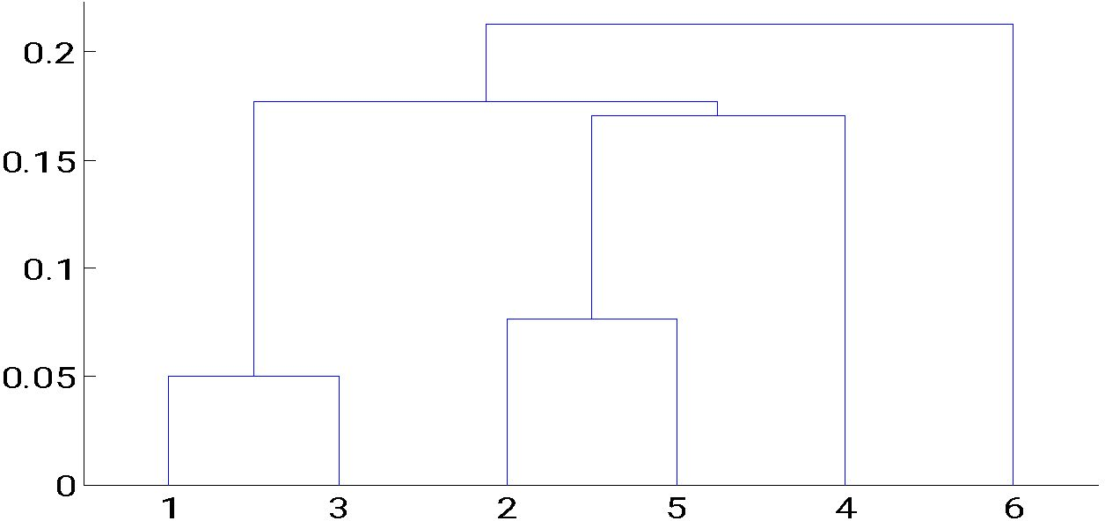
Hierarchical Clustering : Hierarchy represented by a tree structure
This refers to a clustering process that organizes the data into large groups, which contain smaller groups and so on in turn.
Produces a set of nested clusters organized as a hierarchical tree
Can be visualized as a dendrogram
Dendrogram is a visual representation of the compound correlation data.
The individual compounds ( the finest group) are arranged along the bottom of the dendrogram
– A tree like diagram that records the sequences of merges or splits

Slide 10
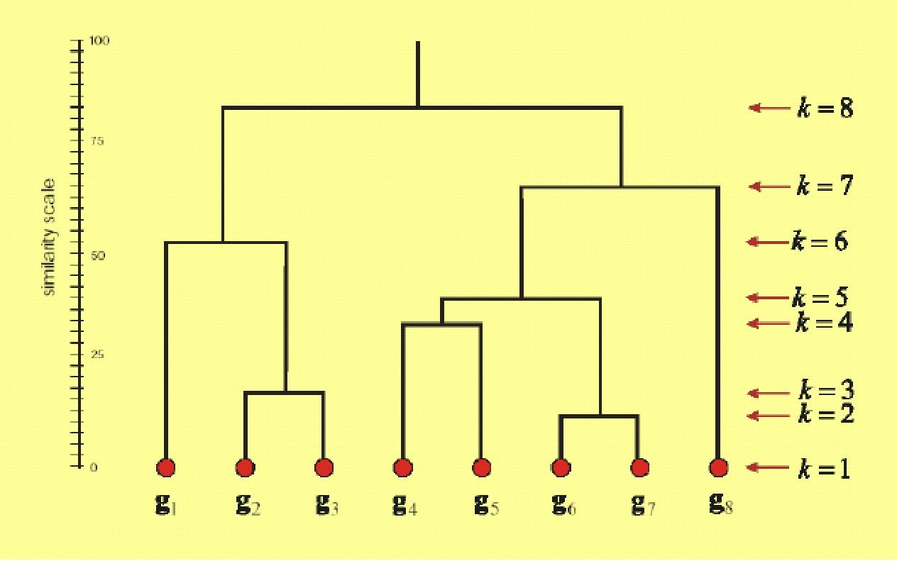
Hierarchical clustering

Slide 11
Strengths of Hierarchical Clustering
Do not have to assume any particular number of clusters
Any desired number of clusters can be obtained by ‘cutting’ the dendogram at the proper level
They may correspond to meaningful taxonomies
Example in biological sciences (e.g., animal kingdom, phylogeny reconstruction,
…)
Pros
Dendrograms are great for visualization Provides hierarchical relations between clusters Shown to be able to capture concentric clusters
Cons
Not easy to define levels for clusters
Experiments showed that other clustering techniques outperform hierarchical clustering

Slide 12
Hierarchical Clustering Continued
Two main types of hierarchical clustering
Agglomerative:
Start with the points as individual clusters
At each step, merge the closest pair of clusters until only one cluster (or k clusters) left
Divisive:
Start with one, all-inclusive cluster
At each step, split a cluster until each cluster contains a point (or there are k clusters)
Traditional hierarchical algorithms use a similarity or distance matrix
– Merge or split one cluster at a time

Slide 13
Agglomerative clustering :
More popular hierarchical clustering technique Basic algorithm is straightforward
This bottom-up strategy starts by placing each object in its own cluster .
Then merges these atomic clusters into larger and larger clusters, until all of the
objects are in a single cluster
or
Until certain termination conditions are satisfied.
It is more popular than divisive methods.
Each node/object is a cluster initially
Merge clusters that have the least dissimilarity
Ex: single-linkage, complete-linkage, Average linking algorithm etc.
Go on in a non-descending fashion
Eventually, all nodes belong to the same cluster

Slide 14
This method Uses Linkage Criteria
Determines the distance between sets of observations as a function of the pairwise distances between observations.
Some commonly used criteria:
Single Linkage:
Distance between two clusters is the smallest pairwise distance between two observations/nodes, each belonging to different clusters.
Complete Linkage:
Distance between two clusters is the largest pairwise distance between two observations/nodes, each belonging to different clusters.
Mean or average linkage clustering:
Distance between two clusters is the average of all the pairwise distances, each node/observation belonging to different clusters.
Centroid linkage clustering:
Distance between two clusters is the distance between their centroids.

Slide 15
Agglomerative Clustering Algorithm
Compute the proximity matrix
Let each data point be a cluster
Repeat
Merge the two closest clusters
Update the proximity matrix
Until only a single cluster remains
Key operation is the computation of the proximity of two clusters
– Different approaches to defining the distance between clusters distinguish the different algorithms
Note : A square matrix in which the entry in cell (j, k) is some measure of the similarity (or distance) between the items to which row j and column k correspond.
A simple example would be a standard mileage chart—the smaller the entry, the closer together are the two items.

Slide 16
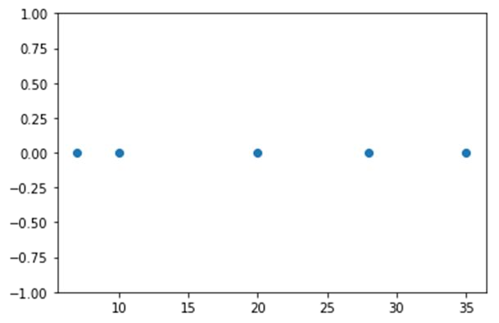
The first two points (5 and 10) are close to each other and should be in the same cluster
Also, the last two points (28 and 35) are close to each other and should be in the same cluster
Cluster of the center point (20) is not easy to conclude
Let’s solve the problem by hand using both the types of agglomerative hierarchical clustering :
Single Linkage : In single link hierarchical clustering, we merge in each step the two clusters, whose two closest members have the smallest distance.

Slide 17
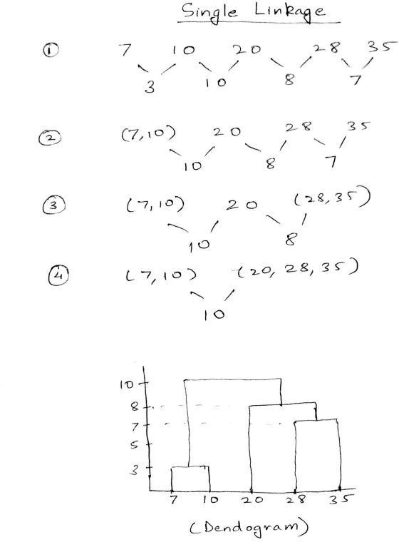
Using single linkage two clusters are formed : Cluster 1 : (7,10)
Cluster 2 : (20,28,35)

Slide 18
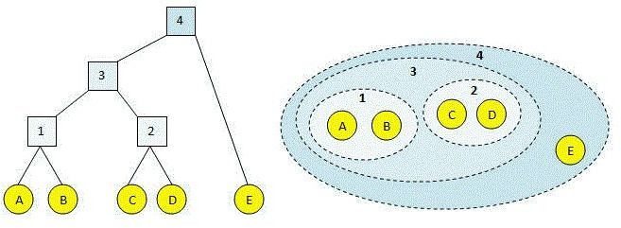
Single linkage… Continued
The single linkage algorithm is also known as the minimum method and the nearest neighbor method.
Consider Ci and Cj as two clusters.
‘a’ and ‘b’ are samples from cluster Ci and Cj respectively. D(Ci,Cj) = min d(a,b) here ‘a’ Ɛ Ci and ‘b’ Ɛ Cj
Where d(a,b) represents the distance between ‘a’ and ‘b’

Slide 19
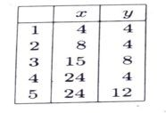
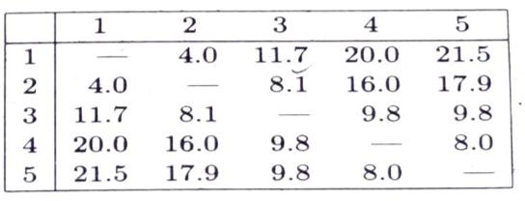
First level of distance computation D1 (Euclidean distance used)

Slide 20
Use Euclidean distance for distance between samples.
The table shown in the previous slide gives feature values for each sample and the distance d between each pair of samples.
The algorithm begins with five clusters, each consisting of one sample.
The two nearest clusters are then merged.
The smallest number is 4 which is the distance between (1 and 2), so they are merged. Merged matrix is as shown in next slide.

Slide 21
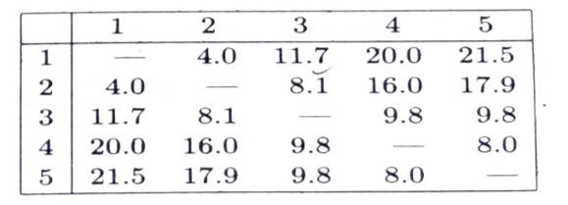
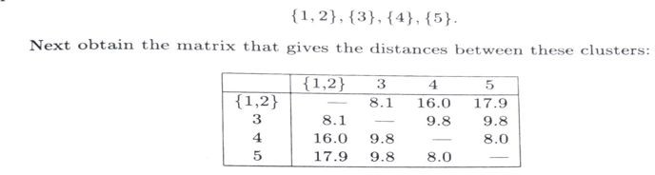
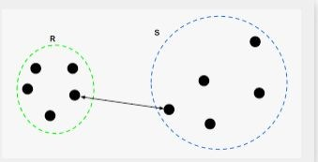
D2 matrix

Slide 22
In the next level, the smallest number in the matrix is 8
It is between 4 and 5.
Now the cluster 4 and 5 are merged.
With this we will have 3 clusters: {1,2}, {3},{4,5}
The matrix is as shown in the next slide.

Slide 23
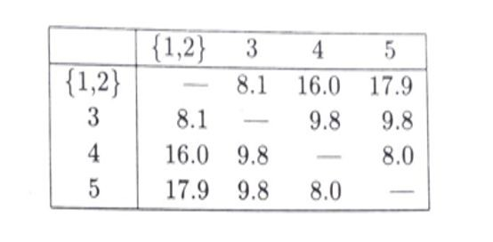
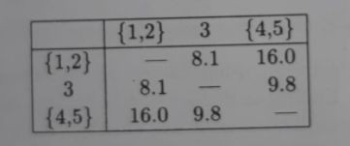
D3 distance

Slide 24
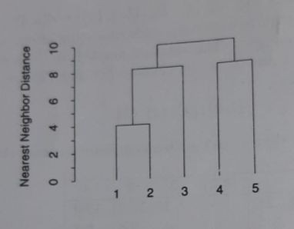
In the next step {1,2} will be merged with {3}.
Now we will have two cluster {1,2,3} and {4,5}
In the next step.. these two are merged to have single cluster.
Dendrogram is as shown here.
Height of the dendrogram is decided based on the merger distance.
For example: 1 and 2 are merged at the least distance 4. hence the height is 4.

Slide 25
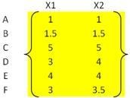

Slide 26
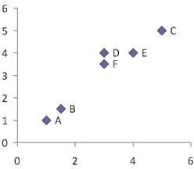
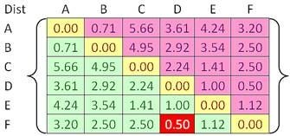
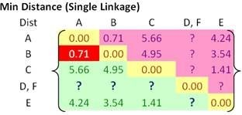

Slide 27
Using the input distance matrix, distance between cluster (D, F) and cluster A is computed as
Distance between cluster (D, F) and cluster B is
Similarly, distance between cluster (D, F) and cluster C is
Finally, distance between cluster E and cluster (D, F) is calculated as

Slide 28
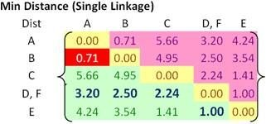
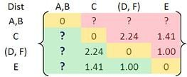
Then, the updated distance matrix becomes
Using the input distance matrix (size 6 by 6), distance between cluster C and cluster (D, F) is computed as
Distance between cluster (D, F) and cluster (A, B) is the minimum distance between all objects involves in the two clusters

Slide 29
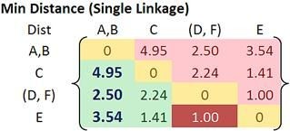
Similarly, distance between cluster E and (A, B) is
Then the updated distance matrix is

Slide 30
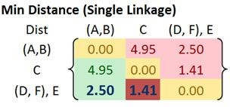
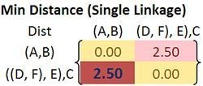
Distance between cluster ((D, F), E) and cluster (A, B) is calculated as
Distance between cluster ((D, F), E) and cluster C yields the minimum distance of 1.41. This distance is computed as

Slide 31
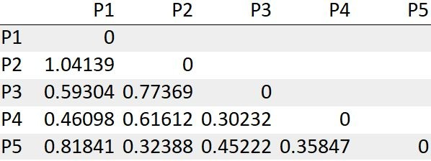
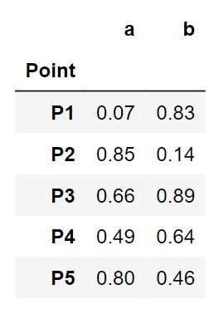
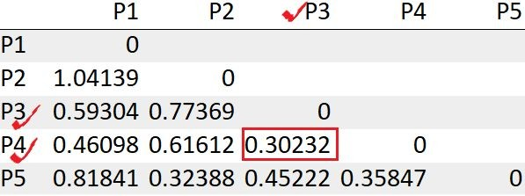
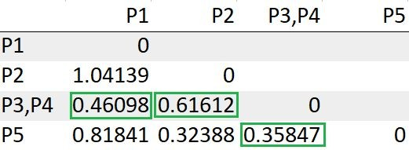
Consider the points
Step1
Step2
Step3

Slide 32
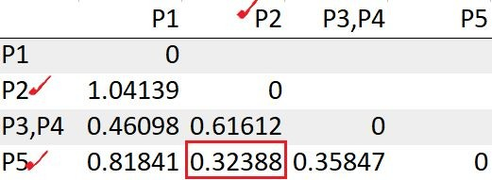
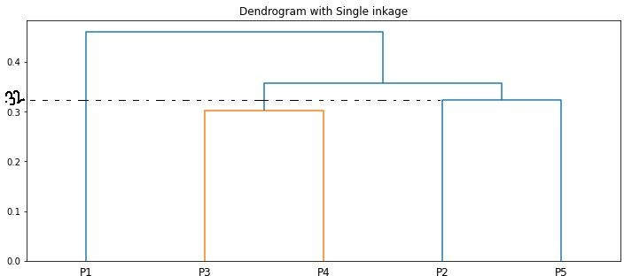
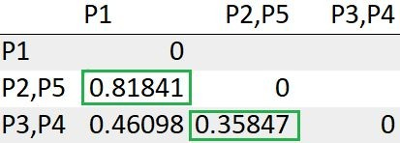
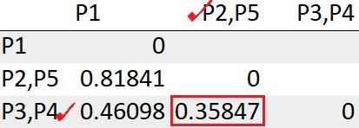
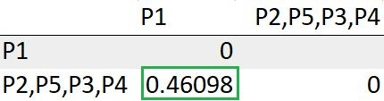

Slide 33
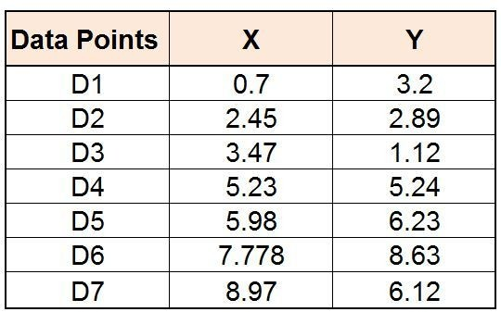
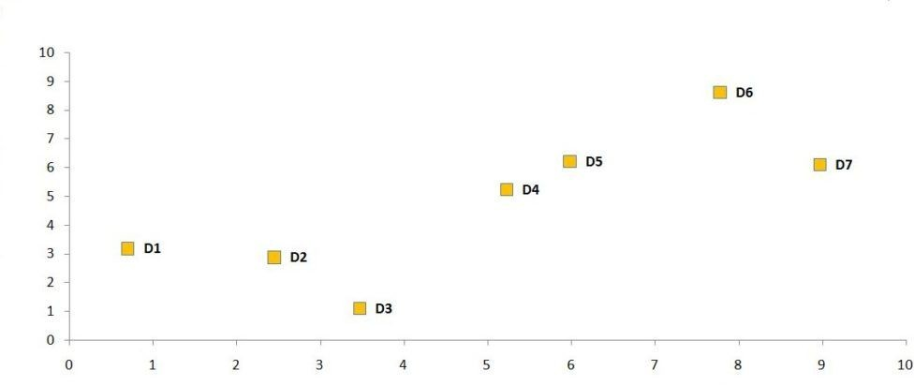
Step 1:
We first create what is known as a distance matrix. Here we compute the distance from each observation to all the observations of the dataset. The distance metric that we are using in this example is Euclidean distance.
The formula for Euclidean distance is:

Slide 34
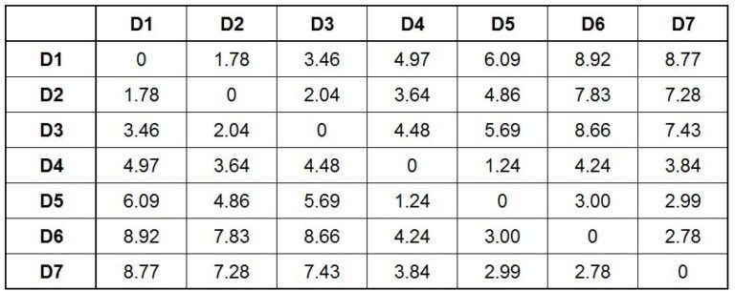
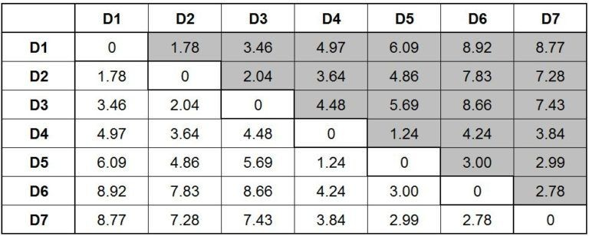
If we look closely, the distances in the upper and lower fold of the distance matrix are same.
Also if we look diagonally, we notice that there are 0s.
For example, when we calculate the distance from D1 to D1, we have 0 distance,
similarly from D2 to D2 and so forth, thus the distance is nil.
Therefore, for the sake of simplicity, we remove the duplicates and 0 values and come up with a simplified distance table.

Slide 35
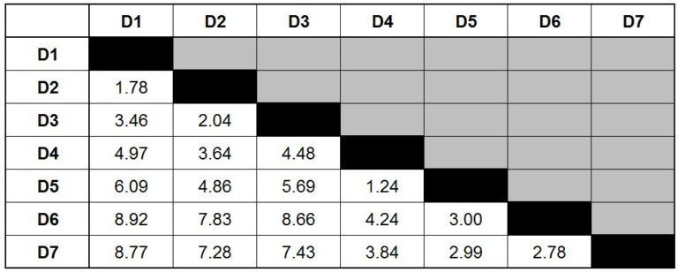
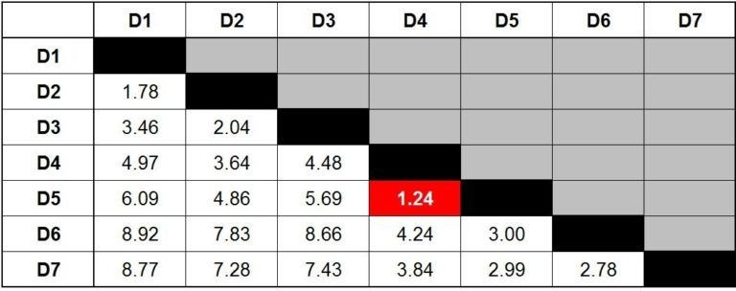
As mentioned at the beginning, Agglomerative clustering is a bottom-up approach, therefore, we merge observations together based on their similarity (minimum distance).
Therefore, we look at the table to find those data points that are closest to each other.
We look for the minimum value in our table and find that the minimum value is 1.24 which is the distance between D4 and D5. Therefore, the two closest data points in the dataset are D4 and D5.
Thus, we merge these two data points to form a cluster. We can now visualise this cluster on the graph and create a dendrogram for it.

Slide 36
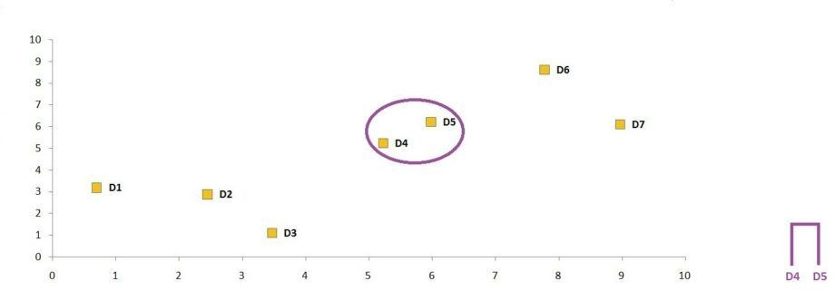
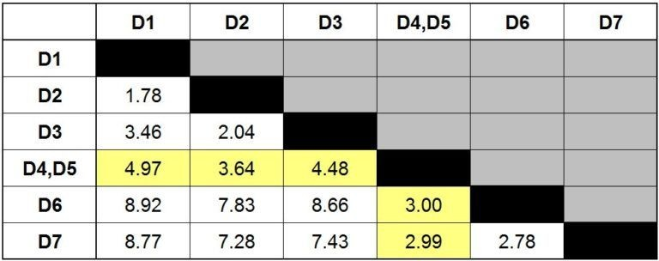
As we are using single linkage, we choose the minimum distance, therefore, we choose 4.97 and consider it as the distance between the D1 and D4, D5. If we were using complete linkage then the maximum value would have been selected as the distance between D1 and D4, D5 which would have been 6.09. If we were to use Average Linkage then the average of these two distances would have been taken. Thus, here the distance between D1 and D4, D5 would have come out to be 5.53 (4.97 + 6.09 / 2).

Slide 37
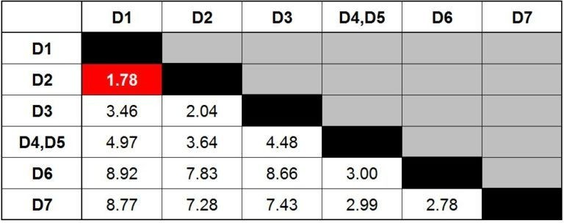
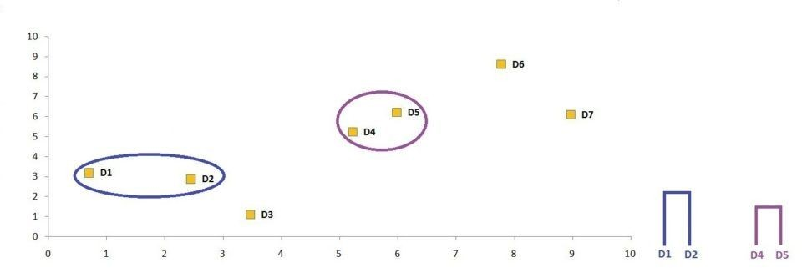
From now on we will simply repeat Step 2 and Step 3 until we are left with one cluster. We again look for the minimum value which comes out to be 1.78 indicating that the new cluster which can be formed is by merging the data points D1 and D2.

Slide 38
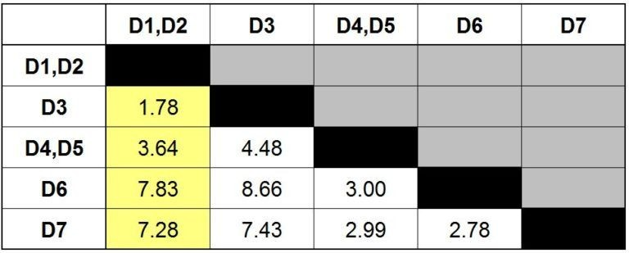
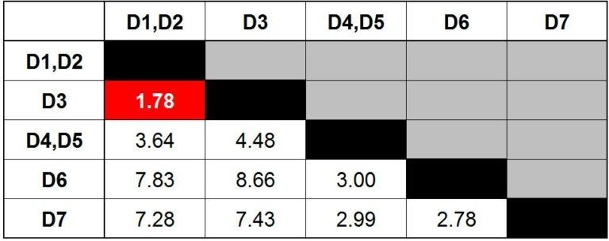
Similar to what we did in Step 3, we again recalculate the distance this time for cluster D1, D2 and come up with the following updated distance matrix.
We repeat what we did in step 2 and find the minimum value available in our distance matrix. The minimum value comes out to be 1.78 which indicates that we have to merge D3 to the cluster D1, D2.

Slide 39
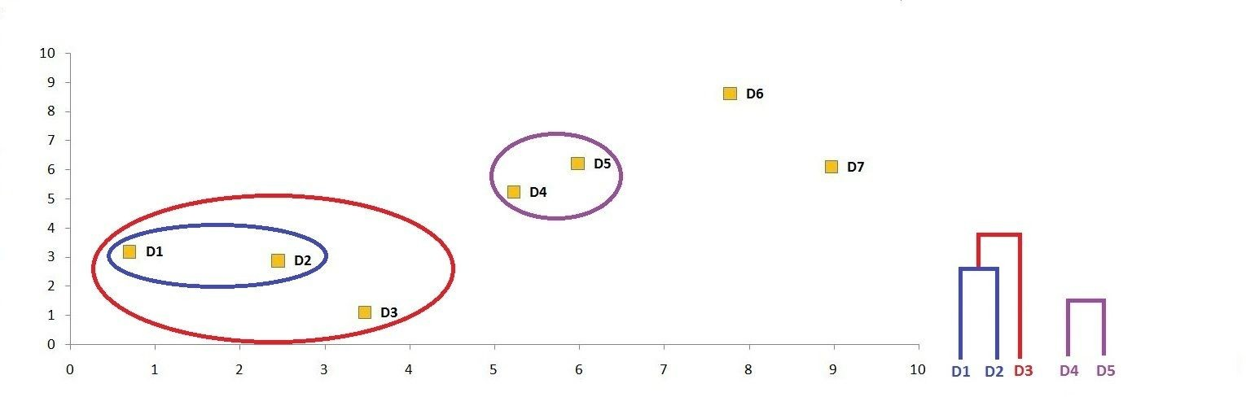

Slide 40
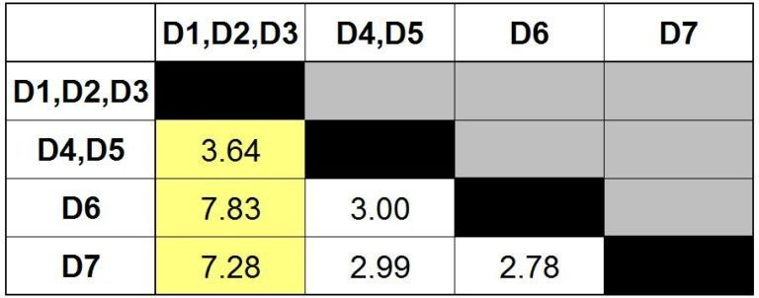
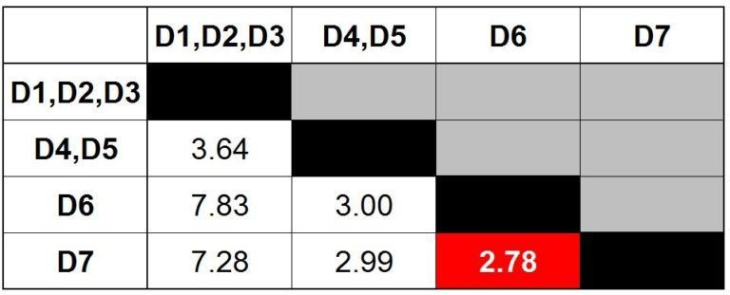
Update the distance matrix using Single Link method.
Find the minimum distance in the matrix.

Slide 41
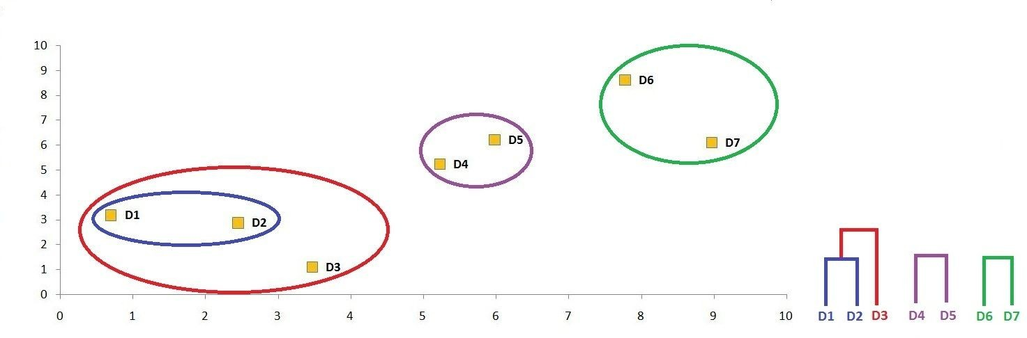
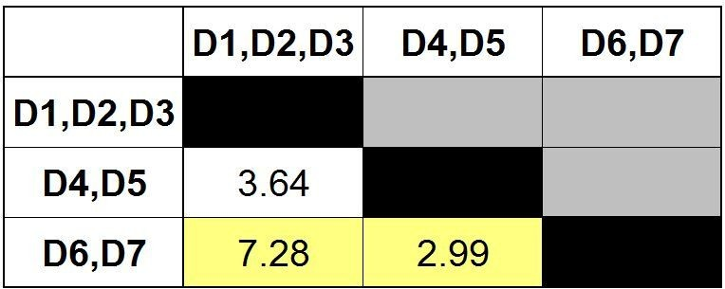
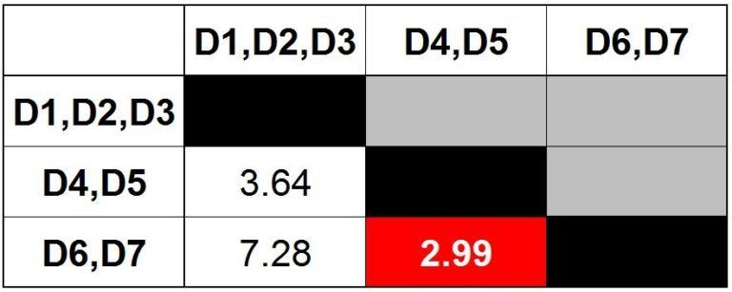
Merge the data points accordingly and form another cluster.
Update the distance matrix using Single Link method.

Slide 42

The complete linkage Algorithm
It is also called the maximum method or the farthest neighbor method.
It is obtained by defining the distance between two clusters to be largest distance between a sample in one cluster and a sample in the other cluster.
If Ci and Cj are clusters, we define:

Slide 43

Complete Linkage : In complete link hierarchical clustering, we merge in the members of the clusters in each step, which provide the smallest maximum pairwise distance.

Slide 44

Example : Complete linkage algorithm
Consider the same samples used in single linkage:
Apply Euclidean distance and compute the distance.
Algorithm starts with 5 clusters.
As earlier samples 1 and 2 are the closest, they are merged first.

Slide 45


While merging the maximum distance will be used to replace the distance/ cost value.
For example, the distance between 1&3 = 11.7 and 2&3=8.1. This algorithm selects 11.7 as the distance.
In complete linkage hierarchical clustering, the distance between two clusters is defined as the longest distance between two points in each cluster.

Slide 46


In the next level, the smallest distance in the matrix is 8.0 between 4 and 5. Now merge 4 and 5.

Slide 47

In the next step, the smallest distance is 9.8 between 3 and {4,5}, they are merged.
At this stage we will have two clusters {1,2} and {3,4,5}.
Notice that these clusters are different from those obtained from single linkage algorithm.
At the next step, the two remaining clusters will be merged.
The hierarchical clustering will be complete.
The dendrogram is as shown in the figure.

Slide 48
The Average Linkage Algorithm
The average linkage algorithm, is an attempt to compromise between the extremes of the single and complete linkage algorithm.
It is also known as the unweighted pair group method using arithmetic averages.

Slide 49


Example: Average linkage clustering algorithm
Consider the same samples: compute the Euclidian distance between the samples

Slide 50

In the next step, cluster 1 and 2 are merged, as the distance between them is the least.
The distance values are computed based on the average values.
For example distance between 1 & 3 =11.7 and 2&3=8.1 and the average is 9.9. This value is replaced in the matrix between {1,2} and 3.

Slide 51

In the next stage 4 and 5 are merged:

Slide 52
Divisive clustering

Slide 53
DIVISIVE CLUSTERING
All the points in the dataset belong to one cluster and split is performed recursively as one moves down the hierarchy.
Steps of Divisive Clustering:
Initially, all points in the dataset belong to one single cluster.
Partition the cluster into two least similar cluster
Proceed recursively to form new clusters until the desired number of clusters is obtained.
How to choose which cluster to split?
Check the sum of squared errors of each cluster and choose the one with the largest value.

Slide 54


Once we have decided to split which cluster, then the question arises on how
to split the chosen cluster into 2 clusters.
One way is to use Ward’s criterion
to
chase for the largest reduction in the difference in the SSE criterion as a result
of the split.

Slide 55

•

Slide 56



Slide 57



Slide 58


Slide 59
Partitional Clustering:
Agglomerative clustering creates a series of Nested clusters.
In partitional clustering the goal is to usually create one set of clusters that partitions the data into similar groups.
Samples close to one another are assumed to be in one cluster. This is the goal of partitional clustering.
Partitional clustering algorithm is used to divide the data set into two groups. Then each group is divided into two parts and so on, a hierarchical dendrogram could be produced from the top down.
The hierarchy is produced using divisive technique is more general than the bottom-up technique used by agglomerative technique because the groups can be divided into more than two subgroups in one step.

Slide 60
One of the simplest partitional algorithm is the Forgy’s algorithm.
Apart from the data, the input to the algorithm is ‘k’ , the number of clusters to be constructed ‘k’ samples are called seed points.
The seed points could be chosen randomly, or some knowledge of the desired could be used to guide their selection.
Forgy’s Algorithm
Initialize the cluster centroid to the seed points.
For each sample, find the cluster centroid nearest to it. Put the sample in the nearest cluster identified with the cluster centroid.
Compute the centroids of the resulting clusters.
Repeat the steps 2 to 3 until sample points do not change their clusters.
stop

Slide 61
Algorithm
Input: D is a dataset containing n objects, k is the number of cluster Output: A set of k clusters
Steps:
1.
2.
Randomly choose k objects from D as the initial cluster centroids.
For each of the objects in D do
Compute distance between the current objects and k cluster centroids
Assign the current object to that cluster to which it is closest.
Compute the “cluster centers” of each cluster. These become the new cluster centroids.
Repeat step 2-3 until the convergence criterion is satisfied
Stop
58

Slide 62
Consider the Data points listed in the table and set k = 2 to produce two clusters Use the first two samples (4,4) and (8,4) as the seed points.
Now applying the algorithm by computing the distance from each cluster centroid and assigning them to the clusters:
Data Points | X | Y
1 | 4 | 4
2 | 8 | 4
3 | 15 | 8
4 | 24 | 4
5 | 24 | 12
Sample | Nearest Cluster Centroid
(4,4) | (4,4)
(8,4) | (8,4)
(15,8) | (8,4)
(24,4) | (8,4)
(24,12) | (8,4)

Slide 63
The clusters {(4,4)} and {(8,4),(15,8),(24,4),(24,12)} are formed. Now re-compute the cluster centroids
The first cluster (4,4) and
The second cluster centroid is x = (8+15+24+24)/4 = 17.75
y = (4+8+4+12)/4 =7
Sample | Nearest Cluster Centroid
(4,4) | (4,4)
(8,4) | (4,4)
(15,8) | (17.75, 7)
(24,4) | (17.75, 7)
(24,12) | (17.75, 7)

Slide 64
The clusters {(4,4),(8,4)} and {(15,8),(24,4),(24,12)} are formed. Now re-compute the cluster centroids
The first cluster centroid x = (4+8)/2 = 6 and y = (4+4)/2 = 4 The second cluster centroid is x = (15+24+24)/3 = 21
y = (8+4+12)/4 = 12
In the next step notice that the cluster centroid does not change And samples also do not change the clusters.
Algorithm terminates.
Sample | Nearest Cluster Centroid
(4,4) | (6,4)
(8,4) | (6,4)
(15,8) | (21,12)
(24,4) | (21,12)
(24,12) | (21,12)

Slide 65

Example-2 Illustration Forgy’s clustering algorithms
Plotting data of Table
A₁ | A₂
6.8 | 12.6
0.8 | 9.8
1.2 | 11.6
2.8 | 9.6
3.8 | 9.9
4.4 | 6.5
4.8 | 1.1
6.0 | 19.9
6.2 | 18.5
7.6 | 17.4
7.8 | 12.2
6.6 | 7.7
8.2 | 4.5
8.4 | 6.9
9.0 | 3.4
9.6 | 11.1
62

Slide 66
Illustration Forgy’s clustering algorithms
Suppose, k=3. Three objects are chosen at random shown as circled. These three centroids are shown below.
Initial Centroids chosen randomly
Centroid |  | Objects
c₁ | 3.8 |  | 9.9
c₂ | 7.8 |  | 12.2
c₃ | 6.2 |  | 18.5
Let us consider the Euclidean distance measure (L₂ Norm) as the distance measurement in our illustration.
Let d₁, d₂ and d₃ denote the distance from an object to c₁, c₂ and c₃ respectively. The distance calculations are shown in Table 16.2.
Assignment of each object to the respective centroid is shown in the right-most column and the clustering so obtained is shown in Fig 16.2.
CS 40003: Data Analytics
63

Slide 67

Illustration Forgy’s clustering algorithms
A₁ | A₂ | d₁ | d₂ | d₃ | cluster
6.8 | 12.6 | 4.0 | 1.1 | 5.9 | 2
0.8 | 9.8 | 3.0 | 7.4 | 10.2 | 1
1.2 | 11.6 | 3.1 | 6.6 | 8.5 | 1
2.8 | 9.6 | 1.0 | 5.6 | 9.5 | 1
3.8 | 9.9 | 0.0 | 4.6 | 8.9 | 1
4.4 | 6.5 | 3.5 | 6.6 | 12.1 | 1
4.8 | 1.1 | 8.9 | 11.5 | 17.5 | 1
6.0 | 19.9 | 10.2 | 7.9 | 1.4 | 3
6.2 | 18.5 | 8.9 | 6.5 | 0.0 | 3
7.6 | 17.4 | 8.4 | 5.2 | 1.8 | 3
7.8 | 12.2 | 4.6 | 0.0 | 6.5 | 2
6.6 | 7.7 | 3.6 | 4.7 | 10.8 | 1
8.2 | 4.5 | 7.0 | 7.7 | 14.1 | 1
8.4 | 6.9 | 5.5 | 5.3 | 11.8 | 2
9.0 | 3.4 | 8.3 | 8.9 | 15.4 | 1
9.6 | 11.1 | 5.9 | 2.1 | 8.1 | 2
64

Slide 68


Illustration Forgy’s clustering algorithms
The calculation new centroids of the three cluster using the mean of attribute values of A₁ and A₂ is shown in the Table below. The cluster with new centroids are shown in Fig 16.3.
Calculation of new centroids
New Centroid |  | Objects
c₁ | 4.6 |  | 7.1
c₂ | 8.2 |  | 10.7
c₃ | 6.6 |  | 18.6
Next cluster with new centroids
65

Slide 69

Illustration of Forgy’s clustering algorithms
We next reassign the 16 objects to three clusters by determining which centroid is closest to each one. This gives the revised set of clusters shown in.
Note that point p moves from cluster C₂ to cluster C₁.
Cluster after first iteration
66

Slide 70

Illustration of Forgy’s clustering algorithms
The newly obtained centroids after second iteration are given in the table below. Note that the centroid c₃ remains unchanged, where c₂ and c₁ changed a little.
With respect to newly obtained cluster centres, 16 points are reassigned again. These are the same clusters as before. Hence, their centroids also remain unchanged.
Considering this as the termination criteria, the k-means algorithm stops here. Hence, the
final cluster in Figure is same as Fig.
Cluster centres after second iteration
Fig 16.5: Cluster after Second iteration
Centroid | Revised Centroids
c₁ | 5.0 | 7.1
c₂ | 8.1 | 12.0
c₃ | 6.6 | 18.6
67

Slide 71
Apply Forgy’s algorithm for the following dataset with K = 2;
Sample | X | Y
1 | 0.0 | 0.5
2 | 0.5 | 0.0
3 | 1.0 | 0.5
4 | 2.0 | 2.0
5 | 3.5 | 8.0
6 | 5.0 | 3.0
7 | 7.0 | 3.0

Slide 72
Pros
Simple, fast to compute
Converges to local minimum of within-cluster squared error
Cons
Setting k
Sensitive to initial centres Sensitive to outliers Detects spherical clusters

Slide 73
K-Means Algorithm: It is similar to Forgy’s algorithm. The k-means algorithm differs from Forgy’s algorithm in that the centroids of the clusters are recomputed as soon as sample joins a cluster. Also unlike Forgy’s algorithm which is iterative in nature, the k-means only two passes through the data set.
The k-means Algorithm
Begin with k clusters, each consisting of one of the first k samples. For each remaining n-k samples, find the centroid nearest it. Put the sample in the cluster identified with this nearest centroid. After each sample is assigned, re-compute the centroid of the altered cluster.
Go through the data a second time. For each sample, find the centroid nearest it. Put the sample in the cluster identified with the nearest cluster. (During this step do not recompute the centroid)

Slide 74


Slide 75

Apply k-means Algorithm on the following sample points
Begin with two clusters {(8,4)} and {(24,4)} with the centroids
(8,4) and (24,4)
For each remaining samples, find the nearest centroid and put it in that Cluster.
Then re-compute the centroid of the cluster.
The next sample (15,8) is closer to (8,4) so it joins the cluster {(8,4)}. The centroid of the first cluster is updated to (11.5,6).
(8+15)/2 = 11.5 and (4+8)/2 = 6.
The next sample is (4,4) is nearest to the centroid (11.5,6) so it
joins the cluster {(8,4),(15,8),(4,4)}.
Now the new centroid of the cluster is (9,5.3)
The next sample (24,12) is closer to centroid (24,4) and joins the cluster {(24,4),(24,12)}.

Slide 76
Now the new centroid of the second cluster is updated to (24,8). At this point step1 is completed.
For step2 examine the samples one by one and put each sample in the identified with the nearest cluster centroid.
The resulting clusters are
{(8,4),(15,8),(4,4)} and {(24,12),(24,4)}
Sample | Distance to centroid (9.5,3) | Distance to centroid (24,8)
(8,4) | 1.6 | 16.5
(24,4) | 15.1 | 4.0
(15,8) | 6.6 | 9.0
(4,4) | 6.6 | 40.0
(24,12) | 16.4 | 4.0

Slide 77
Note: The goal of Forgy’s and k-Means algorithm is to minimize the squared error for a fixed number of clusters.
These algorithms assign samples to clusters so as to reduce the squared error and in the iterative versions, they stop when there is no further reduction..

Slide 78

•
CS 40003: Data Analytics
74

Slide 79
Choosing initial centroids:
Another requirement in the k-Means algorithm to choose initial cluster centroid for each k would be clusters.
It is observed that the k-Means algorithm terminate whatever be the initial choice of the cluster centroids.
It is also observed that initial choice influences the ultimate cluster quality. In other words, the result may be trapped into local optima, if initial centroids are chosen properly.
One technique that is usually followed to avoid the above problem is to choose initial centroids in multiple runs, each with a different set of randomly chosen initial centroids, and then select the best cluster (with respect to some quality measurement criterion, e.g. SSE).
However, this strategy suffers from the combinational explosion problem due to the number of all possible solutions.
75

Slide 80


Slide 81



Segmentation into 3 regions using K = 3
Original Image
Segmentation into 6 regions using k =6

Slide 82


Face Region Detection Using Skin Segmentation
SKIN LESION SEGMENTATION

Slide 83


Dataset3
Ward’s Algorithm
Dataset4
Forgy’s Algorithm

Slide 84

Dataset5
K-Means Algorithm

Slide 85
END OF UNIT 4

